Slide 1
The Simpsons and their mathematical secrets
Material for use in mathematics lessons, based on ideas discussed in The Simpsons and Their Mathematical Secrets
by Simon Singh
Topics:
Introduction
Fermat’s Last Theorem
The Jumbo-Vision Scoreboard
You can find a commentary about this material embedded in the slide notes, which are available in the "normal" PowerPoint view.
You can find out more information at:
http://www.simonsingh.net/Simpsons_Mathematics/teachers/

Slide 2
The Simpsons and their mathematical secrets
Legal Notice: The Simpsons TM and copyright Twentieth Century Fox and its related companies. This presentation is for educational use only. In offering this presentation, we note that we do not benefit financially in any way. The images on these pages were taken from episodes of The Simpsons that are copyrighted by Twentieth Century Fox. Please do not distribute image files, except for use in the classroom. Disclaimer: This presentation, and any content contained relating to The Simpsons are not specifically authorized by Fox.

Slide 3
The Simpsons and their mathematical secrets
Believe it or not, the writers of
The Simpsons have been drip-feeding morsels of mathematics into the series over the last twenty-five years; indeed, there are so many mathematical references in The Simpsons that they could form the basis of an entire university course.
Using specific episodes as jumping off points - from 'Bart the Genius' to 'Treehouse of Horror VI' – this presentation reveals just some of the mathematics hidden in The Simpsons.
You can find out more in The Simpsons and Their Mathematical Secrets, written by Simon Singh. His book introduces readers to The Simpsons' brilliant writing team - the likes of David X. Cohen, Ken Keeler, Al Jean, Jeff Westbrook, and Stewart Burns - who are not only comedy geniuses, but who also hold advanced degrees in mathematics.

Slide 4
1. Introduction

Slide 5
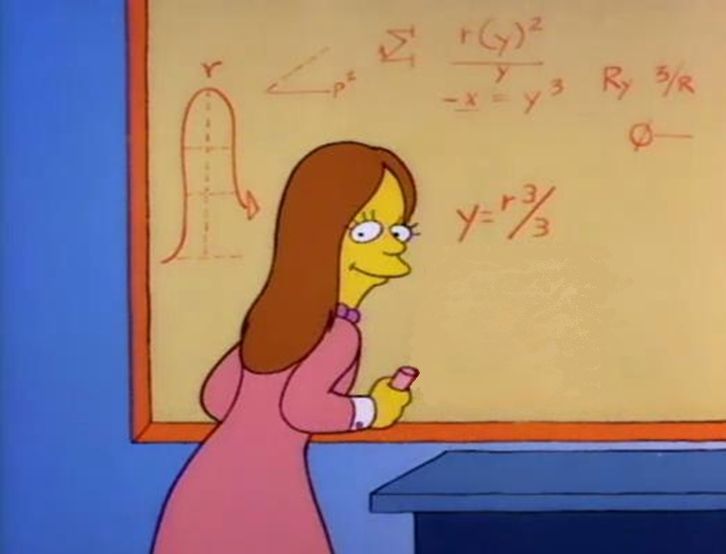
Bart the Genius (1990)
Notes:
Here is a classic example of mathematics in The Simpsons.
“Bart the Genius” (perhaps the first proper episode of The Simpsons, inasmuch as it was the first one to start with the classic opening title sequence) contains a reference to calculus. If you differentiate the equation on the board, you get:
dy/dr = r²... or dy = r.dr.r ... which sounds like mock laughter, “har-dee-har-har”.
It is not the best joke in the world, but it shows that mathematics was embedded in The Simpsons from the very start.

Slide 6
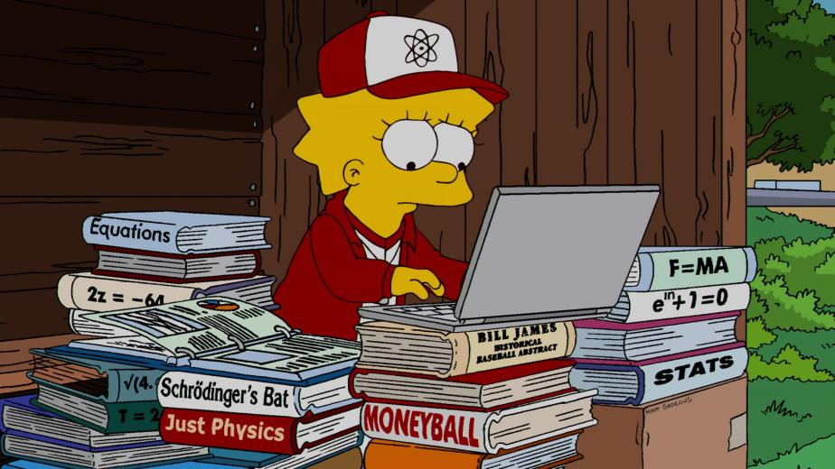
MoneyBART (2010)
Notes:
This example is almost impossible to spot, unless you are a very keen viewer. When Lisa is asked to coach the Little League baseball team, she relies on several piles of books. One of them has Euler’s identity as it title, arguably the most beautiful equation in all of mathematics.

Slide 7
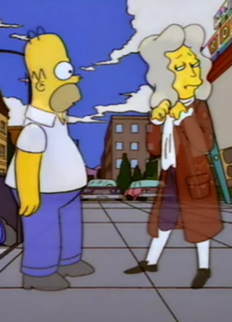
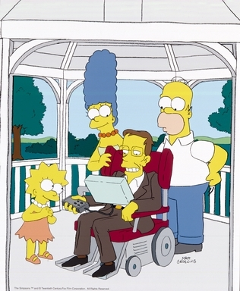
Notes:
As well as mathematics, The Simpsons also has mathematicians. What other TV show has guest appearances by two Lucasian professors of mathematics, namely Isaac Newton and Stephen Hawking? In fact, Professor Hawking has appeared in several episodes and voiced his own character.

Slide 8
2. Fermat’s Last Theorem
Notes:
This section explores two appearances of equations relating to Fermat’s last theorem in The Simpsons.

Slide 9
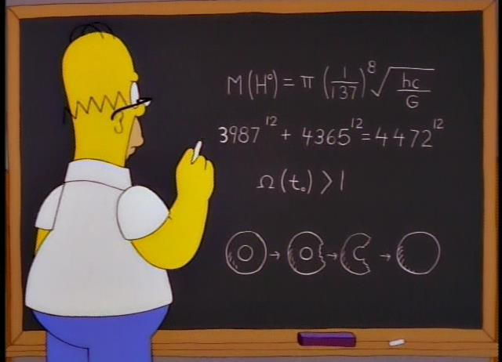
Wizard of Evergreen Terrace (1998)
Notes:
In this episode, Homer Simpsons wants to become an inventor like Thomas Edison.
During a period of intense inventing, we see Homer at a blackboard Line 1 predicts the mass of the Higgs boson, line 3 relates to the density of the universe, and line 4 is all about topological transformations.
But what about the second line?

Slide 10
Wizard of Evergreen Terrace (1998)
Notes:
The second equation relates to Fermat’s last theorem, perhaps the most notorious problem in the history of mathematics.

Slide 11
Pythagoras’ equation has an infinite solutions x² + y² = z² Fermat’s equations have no solutions x³ + y³ = z³ x⁴ + y⁴ = z⁴ x⁵ + y⁵ = z⁵ : x^{n} + y^{n} = z^{n} n, any number bigger than 2
Notes:
Whereas Pythagoras’ equation has an infinite number of solutions (e.g., x=3, y=4, z=5 or x=5, y=12, z=13), Fermat claimed that his set of equations (n>2) has no solutions. Moreover, he said that he could prove it.
In the margin of a book he wrote in Latin: “I have a truly marvelous proof, which this margin is too narrow to contain.” Because he did not write down the actual proof, mathematicians spent centuries trying to rediscover the proof. In the 1990s, Professor Andrew Wiles found a proof and showed that Fermat was correct,
i.e., Fermat’s equations DO NOT HAVE ANY WHOLE NUMBER NON-TRIVIAL SOLUTIONS! But look again at Homer’s blackboard…

Slide 12
Wizard of Evergreen Terrace (1998)
Notes:
The second line offers numbers that fit a Fermat-type equation!!!!!!!!! This should not exist. Who is right? Homer Simpson or the entire mathematical community?
If you check Homer’s numbers on an ordinary calculator, the equation works…… but that is only because your calculator display is limited to roughly 10 significant places.
Homer’s solutions is known as a near-miss solution, which means it is only very slightly inaccurate, and the error is so small that most calculators will not show a discrepancy. But the error becomes obvious on a calculator that can show more digits or a computer with a proper display – as you will see on the next slide.

Slide 13
Wizard of Evergreen Terrace (1998)
3,987¹² + 4,365¹² =
3,987¹² + 4,365¹² = 4,472.0000000071...¹²
Notes:
With more accuracy, we can see that Homer’s solution is merely a rounding down of the genuine solution, which is indeed a near-miss solution.

Slide 14
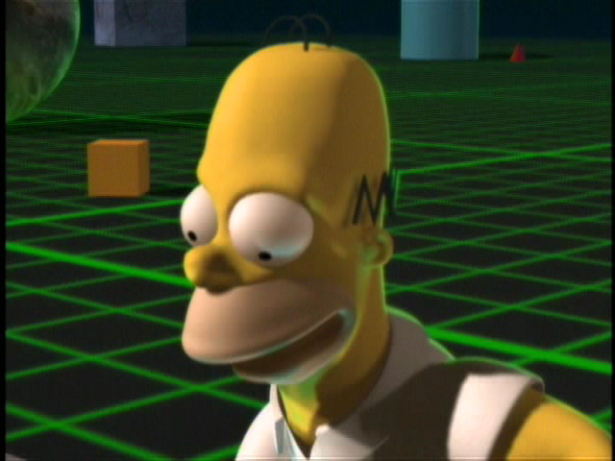
Treehouse of Horror VI (1995)
Notes:
Another Fermat near-miss solution appears in this episode, Treehouse of Horror VI. This episode has three stories, and slide is from the story Homer³, where Homer is dragged into a higher dimensional landscape.

Slide 15
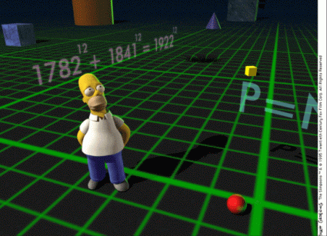
Notes:
You can see the Fermat near-miss solution behind Homer, flying through the special 3-D landscape. It is relatively easy to show that this is a false solution – notice that the left side of the equation must be odd, because it has an odd component and an even component, whereas the right side of the equation must be even – therefore the equation cannot balance.

Slide 16
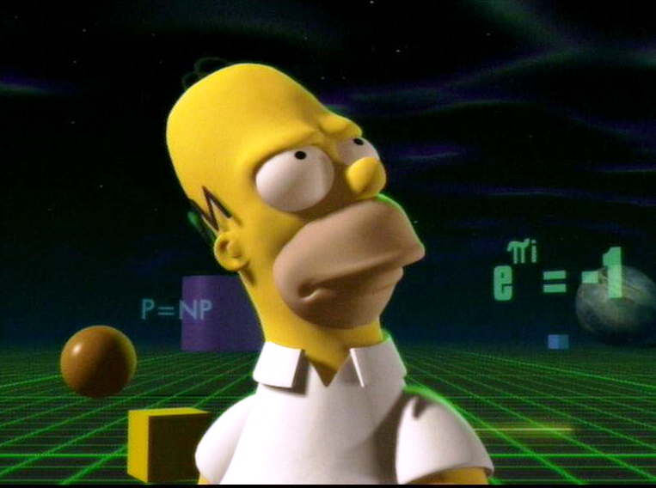
Notes:
By the way, this same episode contains a reference to the Euler identity (over Homer’s left shoulder) and the so-called P v NP conjecture (over Homer’s right shoulder), which has a $1 million prize for whoever can prove it. This episode contains many other mathematical cameos.
You can find more about P v NP at http://newsoffice.mit.edu/2009/explainer-pnp

Slide 17
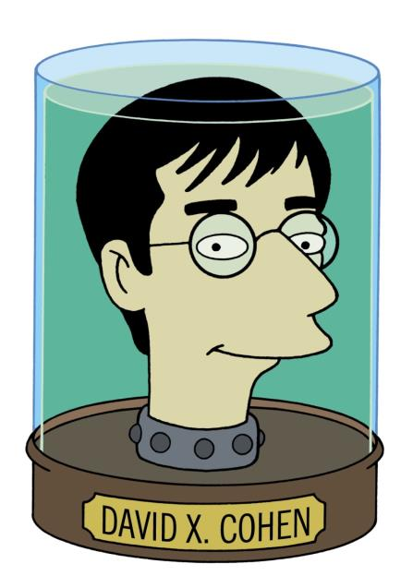
The writer who put Fermat’s last theorem into two episodes of
The Simpsons is
David X. Cohen. He has a degree in physics, a masters in computer science and has published mathematical research papers on pancake sorting.

Slide 18
You can find out the complete story of Fermat’s last theorem in Simon Singh’s book.
Or you can watch his BBC film about Fermat’s last theorem on YouTube.
https://www.youtube.com/watch?v=E7Bqx65liIE

Slide 19
The Simpsons and their mathematical secrets
These two Numberphile videos by Simon Singh are relevant to
Fermat’s last theorem & The Simpsons and are available on YouTube.
Homer Simpson vs Pierre de Fermat
https://www.youtube.com/watch?v=ReOQ300AcSU
Fermat’s Last Theorem
https://www.youtube.com/watch?v=qiNcEguuFSA
Notes:
END OF THIS SECTION

Slide 20
3. The Jumbo-Vision Scoreboard

Slide 21
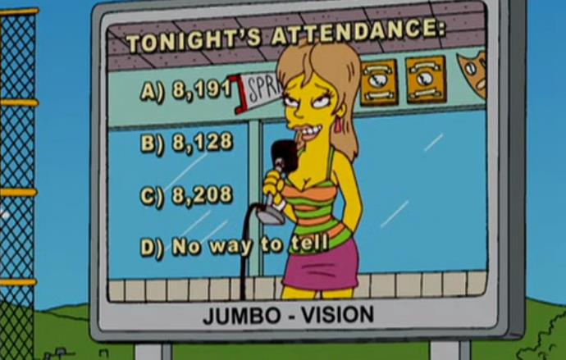
Marge + Homer Turn a Couple Play (2006)
Notes:
Example (3) of mathematics hidden in The Simpsons.

Slide 22
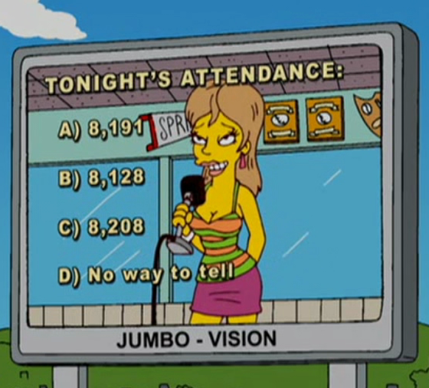
The Plot
Tabitha Vixx is married to baseball star Buck Mitchell. AfterHomer and Marge help the couple to repair their marriage, Tabitha appears on the giant stadium screen to declare her love for Buck.
At the same time, a question and three numbers appear on the screen. Were these numbers plucked out of the air or did the writers pick them for their mathematical qualities?
Notes:
The answer to the question on the slide is that the three numbers are mathematically very significant. Let’s take them one by one.

Slide 23
8,191
A prime
Mersenne
₂^{p} _{– 1}
₂¹³ _{– 1}
Ten largest primes are Mersenne
Notes:
8,191 is a Mersenne prime.
Mersenne numbers have the form shown on the slide, where p is a prime number. Not all Mersenne numbers are primes, but those that are prime have the label “Mersenne prime”.
Students can experiment with different values for p to calculate the resulting Mersenne number, and then determine whether or not it is also a Mersenne prime.
The ten largest primes that we know of – so-called “titanic primes” – are all Mersenne primes.

Slide 24
8,128
Perfect
6 = 3 +2+1
28 = 14 + 7 + 4 + 2 + 1
496
Same no. of Mersennes & even perfects
Notes:
8,128 is the fourth perfect number, which means that the divisors of the number add up to the number itself.
The first perfect number is 6, then 28, then 496.
Students might like to work out the divisors of 496 (1, 2, 4, 8, 16, 31, 62, 124, 248 and 496), and check that it is indeed perfect.
The fifth perfect number, after 8,128, is 33,550,336. As you can see, perfect numbers are very few and far between.
There is a link between perfect numbers and Mersenne primes (discussed in the previous slide), i.e., there is the same number of Mersenne primes as the number of even perfect numbers. So far, all perfect numbers have turned out to be even, but you never know…

Slide 25
8,208
8⁴ + 2⁴ + 0⁴ + 8⁴
= 4,096 + 16 + 0 + 4,096
= 8,208
371=3³+7³+ 1³
Narcissistic
115,132,219,018,763,992,565,095,597,973,971,522,401
Notes:
8,208 has a peculiar property that few will know about.
Count the digits – 4
Then raise each digit to this 4th power
Add each digit raised to the 4th power … and the sum equals the original number, 8,208.
371 shares the same property – only 3 digits, so raise each digit to the third power … and the sum equals the original number.
Such numbers are known as narcissistic numbers.
There are only 88 narcissistic numbers. The largest one is shown and contains 39 digits.
More at http://www.numberuniverse.com/pdf/en/narcisstistic-number.pdf
Where else would you find a Mersenne prime, a perfect number and a narcissistic number hidden in a plot about material reconciliation.

Slide 26
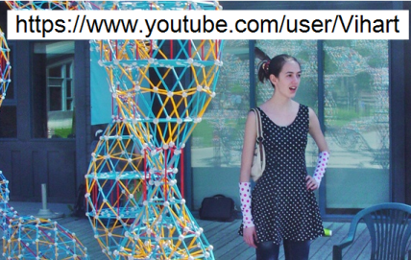
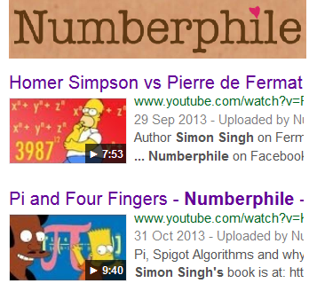
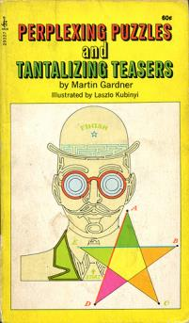
For more mathematics…
Read Martin Gardner’s great books
Watch Vi Hart videos
Watch Numberphile videos

